Slide 1

Movie Recommendation System Using Apache Spark and Python
#1
End-to-end Big Data Project To Build A Movie Recommendation System Using
Apache Spark and Python.
Final Project Status Report
BRIGHT KYEREMEH

Slide 2
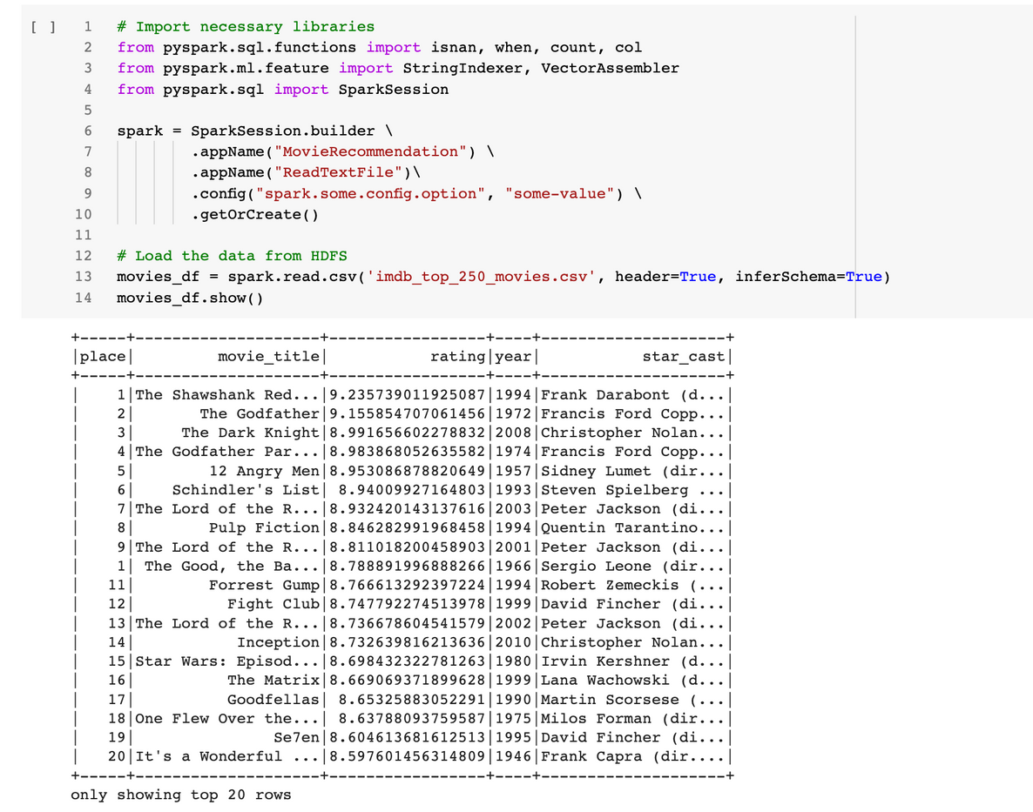
sample dataset output
STEPS
Data Extraction
The data to be used for this project will come from the IMDB database.
01
The dataset is first extracted from the IMDB website via python libraries such as beautiful soup. The dataset is then saved and load from HDFS into spark dataframe.
Loading and exploring data
02
BRIGHT KYEREMEH

Slide 3
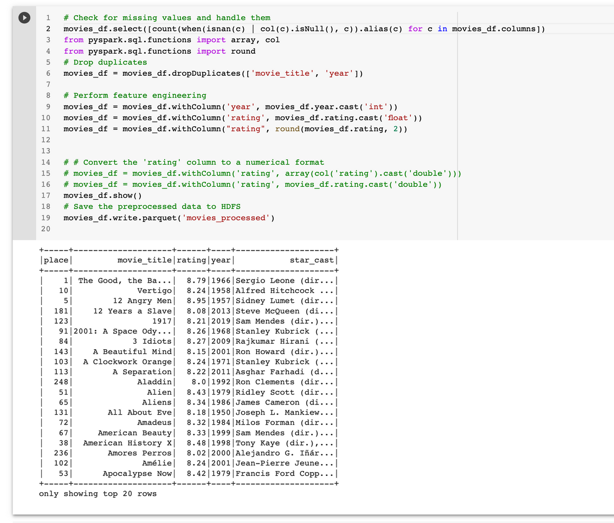
sample dataset output
STEPS
The dataset is then check for:
missing values
dropping duplicate values
feature engineered the year and rating
saved the processed file
Data Preparation
03
BRIGHT KYEREMEH

Slide 4
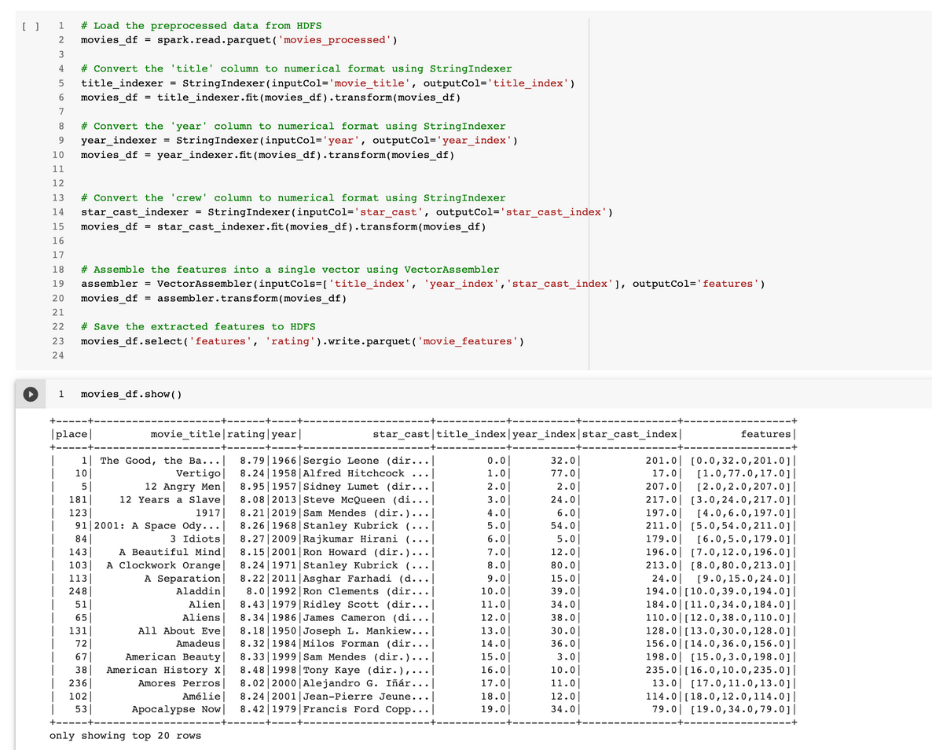
sample dataset output
STEPS
Here we create a column called "feature" which contains index values for the movie titles, year and crew. We will based on this feature to build a recommendation model using Alternating Least Squares (ALS) in pyspark or any other ML algorithm that will work best during the model building stage.
Further feature engineering
04
BRIGHT KYEREMEH

Slide 5
Task
In my project I want to also build an sentiment analysis and display on the UI for users to know the review of the movie as well. For this task, I will also need the movie reviews. This will be part of my next steps.
Get Reviews
01
NEXT STEPS
I will also want to get even more current data for my project as well. some other sources I plan to get data include : https://en.wikipedia.org/wiki/List_of_American_films_of_2020
Which will help me get more current data.
02
Get more data
BRIGHT KYEREMEH

Slide 6
Week 1: Data collection
Week 2 : Data preprocessing
Week 3: Performing feature extraction
Week 4: Building machine learning using PySpark's MLlib
Week 5: Evaluating and tuning the model for best performance
Week 6: Deployment and integration of the model using Python flask or Heroku cloud or other cloud platforms as described above
Weekly Schedule
BRIGHT KYEREMEH

